Slide 1

HNDIT2417
Mobile Application Development
www.hndit.com
Week 3- Linear Layout and RelativeLayout

Slide 2
Linear Layout and RelativeLayout
www.hndit.com

Slide 3
Linear Layout
www.hndit.com
Supports 2 orientations:
  Horizontal
  Vertical

Slide 4
Horizontal Orientation
www.hndit.com
One row, many columns
Items placed beside each other
# # # # # # # # # #

Slide 5
Vertical Orientation
www.hndit.com
One column, many rows
Items stacked on top of each other
#
#
#
#
#
#

Slide 6
Gravity
www.hndit.com
Two types of Gravity in Android
  gravity
  layout_gravity

Slide 7
android:gravity
www.hndit.com
Positions the contents of the view (what is inside the view)
Has several values:
  top
  bottom
  left
  right
  center (horizontal and vertical)
  center_vertical
  center_horizontal

Slide 8
android:gravity
www.hndit.com
Use bit masking to combine multiple values
android:gravity="center_horizontal|bottom“
android:gravity=“top|bottom”
android:gravity=“top|right”

Slide 9
android:layout_gravity
www.hndit.com
Positions the view with respect to its parent
Supports same values as android:gravity
Not all ViewGroups support this attribute.

Slide 10
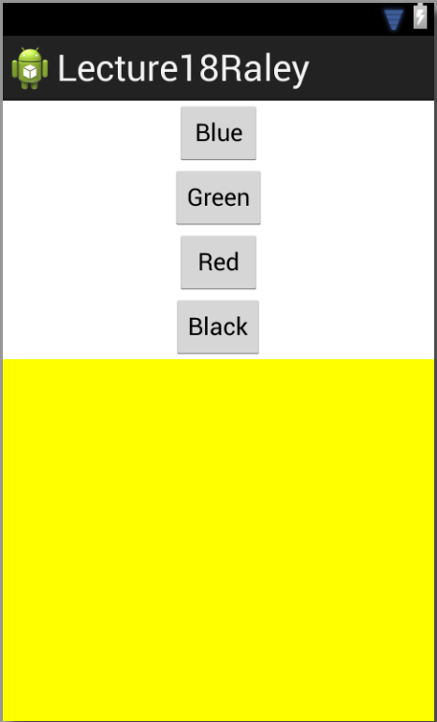
gravity vs. layout_gravity
www.hndit.com
Using gravity on a ViewGroup will position all of its children a specific way.
Using a LinearLayout as the root view to encapsulate everything.
The LinearLayout has an attribute of
gravity with a value equal to center.
(That is why all the button are centered
in the screen.)

Slide 11
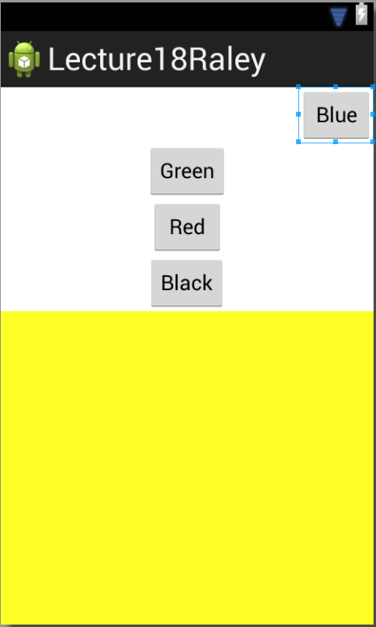
gravity vs. layout_gravity
www.hndit.com
Using layout_gravity, a child can override the gravity set on it by its parent.
Using a LinearLayout as the root view to encapsulate everything.
The blue button has an attribute of
layout_gravity with a value equal to right.
(That is why all the button are centered
in the screen, except the blue button which is on the right.)

Slide 12
What does this render?
www.hndit.com
<?xml version="1.0" encoding="utf-8"?>
<LinearLayout xmlns:android="http://schemas.android.com/apk/res/android"
android:orientation="vertical"
android:layout_width=“match_parent"
android:layout_height="match_parent" >
<LinearLayout
android:orientation="horizontal"
android:layout_width="wrap_content"
android:layout_height="wrap_content"
android:gravity="center" >
<TextView
android:layout_width="wrap_content"
android:layout_height="wrap_content"
android:text="@string/hello" />
<ImageView
android:layout_width="wrap_content"
android:layout_height="wrap_content"
android:src="@drawable/icon" />
</LinearLayout>
</LinearLayout>

Slide 13
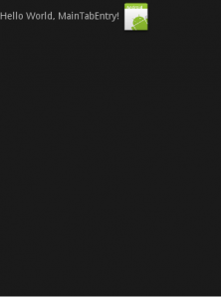
What does this render?
www.hndit.com
<?xml version="1.0" encoding="utf-8"?>
<LinearLayout xmlns:android="http://schemas.android.com/apk/res/android"
android:orientation="vertical"
android:layout_width=“match_parent"
android:layout_height="match_parent" >
<LinearLayout
android:orientation="horizontal"
android:layout_width="wrap_content"
android:layout_height="wrap_content"
android:gravity="center" >
<TextView
android:layout_width="wrap_content"
android:layout_height="wrap_content"
android:text="@string/hello" />
<ImageView
android:layout_width="wrap_content"
android:layout_height="wrap_content"
android:src="@drawable/icon" />
</LinearLayout>
</LinearLayout>

Slide 14
Why isn’t the content centered?
www.hndit.com
<?xml version="1.0" encoding="utf-8"?>
<LinearLayout xmlns:android="http://schemas.android.com/apk/res/android"
android:orientation="vertical"
android:layout_width=“match_parent"
android:layout_height="match_parent" >
<LinearLayout
android:orientation="horizontal"
android:layout_width="wrap_content"
android:layout_height="wrap_content"
android:gravity="center" >
<TextView
android:layout_width="wrap_content"
android:layout_height="wrap_content"
android:text="@string/hello" />
<ImageView
android:layout_width="wrap_content"
android:layout_height="wrap_content"
android:src="@drawable/icon" />
</LinearLayout>
</LinearLayout>

Slide 15
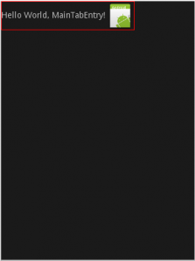
What is the width of the LinearLayout?
www.hndit.com
<?xml version="1.0" encoding="utf-8"?>
<LinearLayout xmlns:android="http://schemas.android.com/apk/res/android"
android:orientation="vertical"
android:layout_width=“match_parent"
android:layout_height="match_parent" >
<LinearLayout
android:orientation="horizontal"
android:layout_width="wrap_content"
android:layout_height="wrap_content"
android:gravity="center" >
<TextView
android:layout_width="wrap_content"
android:layout_height="wrap_content"
android:text="@string/hello" />
<ImageView
android:layout_width="wrap_content"
android:layout_height="wrap_content"
android:src="@drawable/icon" />
</LinearLayout>
</LinearLayout>

Slide 16
What is the width of the LinearLayout?
www.hndit.com
<?xml version="1.0" encoding="utf-8"?>
<LinearLayout xmlns:android="http://schemas.android.com/apk/res/android"
android:orientation="vertical"
android:layout_width=“match_parent"
android:layout_height="match_parent" >
<LinearLayout
android:orientation="horizontal"
android:layout_width="wrap_content"
android:layout_height="wrap_content"
android:gravity="center" >
<TextView
android:layout_width="wrap_content"
android:layout_height="wrap_content"
android:text="@string/hello" />
<ImageView
android:layout_width="wrap_content"
android:layout_height="wrap_content"
android:src="@drawable/icon" />
</LinearLayout>
</LinearLayout>
Because the parent LinearLayout has width “wrap_content”, it’s essentially “hugging” the two views inside and so they have no space to center themselves in.

Slide 17
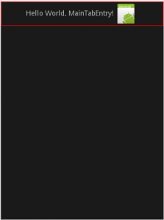
Adjust LinearLayout Width
www.hndit.com
<?xml version="1.0" encoding="utf-8"?>
<LinearLayout xmlns:android="http://schemas.android.com/apk/res/android"
android:orientation="vertical"
android:layout_width=“match_parent"
android:layout_height="match_parent" >
<LinearLayout
android:orientation="horizontal"
android:layout_width=“match_parent"
android:layout_height="wrap_content"
android:gravity="center" >
<TextView
android:layout_width="wrap_content"
android:layout_height="wrap_content"
android:text="@string/hello" />
<ImageView
android:layout_width="wrap_content"
android:layout_height="wrap_content"
android:src="@drawable/icon" />
</LinearLayout>
</LinearLayout>
A possible fix is to make the linearlayout as wide as its parent so use match_parent

Slide 18
Take 2: What does this render?
www.hndit.com
<?xml version="1.0" encoding="utf-8"?>
<LinearLayout xmlns:android="http://schemas.android.com/apk/res/android"
android:orientation="vertical"
android:layout_width=“match_parent"
android:layout_height=“match_parent" >
<LinearLayout
android:orientation="horizontal"
android:layout_width=“match_parent"
android:layout_height="wrap_content" >
<TextView
android:layout_width="wrap_content"
android:layout_height="wrap_content"
android:layout_gravity="left"
android:text="@string/hello" />
<ImageView
android:layout_width="wrap_content"
android:layout_height="wrap_content"
android:layout_gravity="right"
android:src="@drawable/icon" />
</LinearLayout>
</LinearLayout>

Slide 19
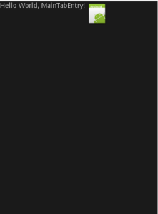
Take 2: What does this render?
www.hndit.com
<?xml version="1.0" encoding="utf-8"?>
<LinearLayout xmlns:android="http://schemas.android.com/apk/res/android"
android:orientation="vertical"
android:layout_width=“match_parent"
android:layout_height=“match_parent" >
<LinearLayout
android:orientation="horizontal"
android:layout_width=“match_parent"
android:layout_height="wrap_content" >
<TextView
android:layout_width="wrap_content"
android:layout_height="wrap_content"
android:layout_gravity="left"
android:text="@string/hello" />
<ImageView
android:layout_width="wrap_content"
android:layout_height="wrap_content"
android:layout_gravity="right"
android:src="@drawable/icon" />
</LinearLayout>
</LinearLayout>
Okay so my my parent fills the entire width and I tell the TextView to position itself with respect to its parent on the left, and I tell the ImageView to position itself with respect to its parent on the right, but how come it doesn’t work?

Slide 20
LinearLayouts and layout_gravity
www.hndit.com
Depending on the orientation of the LinearLayout, the LinearLayout’s children can only use certain values for layout_gravity.

Slide 21
layout_gravity with horizontal orientation
www.hndit.com
For a horizontal Linear Layout the following values make sense:
  top
  center
  Bottom
That is because the children of a horizontal Linear Layout are laid out horizontally one after the other.
With horizontal orientation, the only thing can be controlled using the android:layout_gravity is how a child view is positioned vertically.

Slide 22
layout_gravity with vertical orientaiton
www.hndit.com
For a vertical Linear Layout the following values make sense:
  left
  center
  Right
That is because the children of a vertical Linear Layout are laid out vertically one below the other.
With vertical orientation, the only thing can be controlled using the android:layout_gravity is how a child view is positioned horizontally.

Slide 23
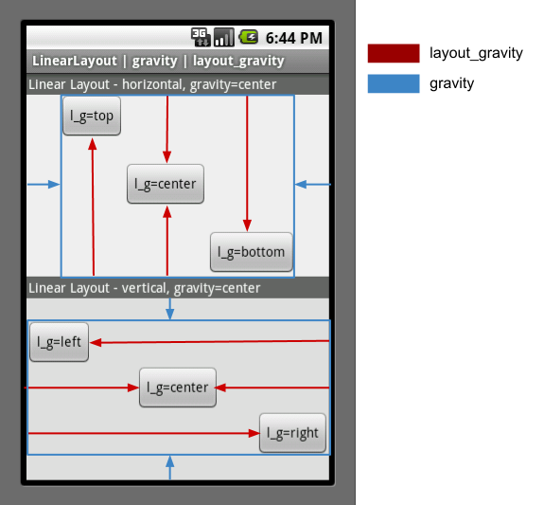
layout_gravity & gravity Example
www.hndit.com

Slide 24
layout_weight
www.hndit.com
Attribute only works for LinearLayout
Indicates how much of the extra space in the LinearLayout will be allocated to the view associated with this attribute.

Slide 25
layout_weight
www.hndit.com
The size of the View will be determined based on the relation of all sibling’s weights to each other.
If, for example, all views define the same weight, then the available space will be distributed equally among them.

Slide 26
layout_weight
www.hndit.com
Which axis (width or height) should be affected can be controlled by setting the respective size to a value of 0dp.
Weights don’t have to add up to 1, although it’s common to distribute layout weight over all children as fractions of 1 (percentage semantics).
The relation between all weights is what matters.

Slide 27
Problem
www.hndit.com
I have 4 Views whose width I want to be equally distributed inside their parent.
I want this to work on any device, and I don’t want to calculate the width each time the app runs.

Slide 28
layout_weight to the rescue
www.hndit.com
Using layout_weight we can assign an equal weight to each child view and at runtime the LinearLayout will equally distribute any remaining space to the children.

Slide 29
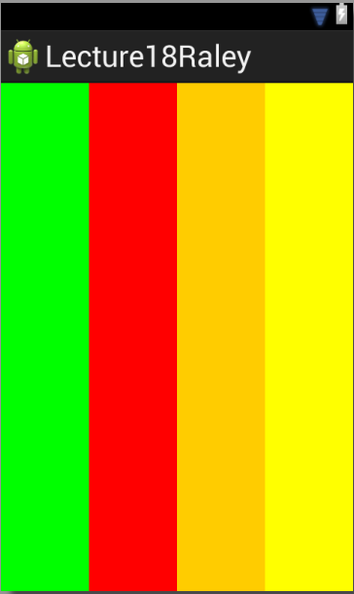
layout_weight to the rescue
www.hndit.com
<?xml version="1.0" encoding="utf-8"?>
<LinearLayout xmlns:android="http://schemas.android.com/apk/res/android"
android:id="@+id/pink"
android:layout_width="match_parent"
android:layout_height="match_parent"
android:orientation="horizontal"
android:background="#00F" >
<View
android:layout_width="0dp"
android:layout_height="match_parent"
android:layout_weight=".25"
android:background="#0F0"/>
<View
android:layout_width="0dp"
android:layout_height="match_parent"
android:layout_weight=".25"
android:background="#F00"/>
<View
android:layout_width="0dp"
android:layout_height="match_parent"
android:layout_weight=".25"
android:background="#FC0"/>
<View
android:layout_width="0dp"
android:layout_height="match_parent"
android:layout_weight=".25"
android:background="#FF0"/>
</LinearLayout>

Slide 30
RelativeLayout
www.hndit.com

Slide 31

About RelativeLayout
www.hndit.com
RelativeLayout is a view group that displays child views in relative positions.

Slide 32
About RelativeLayout
www.hndit.com
The position of each child view can be specified as relative to other sibling elements (such as to the left-of or below another view) or in positions relative to the parent area (such as aligned to the bottom, left of center).
layout_alignParentTop
layout_below
layout_alignParentLeft
layout_below
layout_alignParentRight

Slide 33
About RelativeLayout
www.hndit.com
By default, all child views are drawn at the top-left of the layout, so you must define the position of each view using the various layout properties.

Slide 34
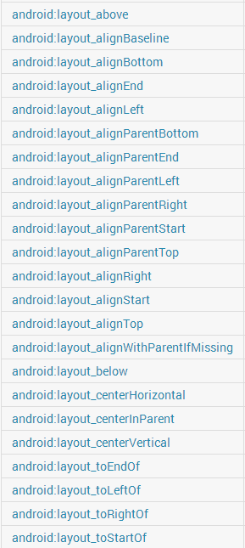
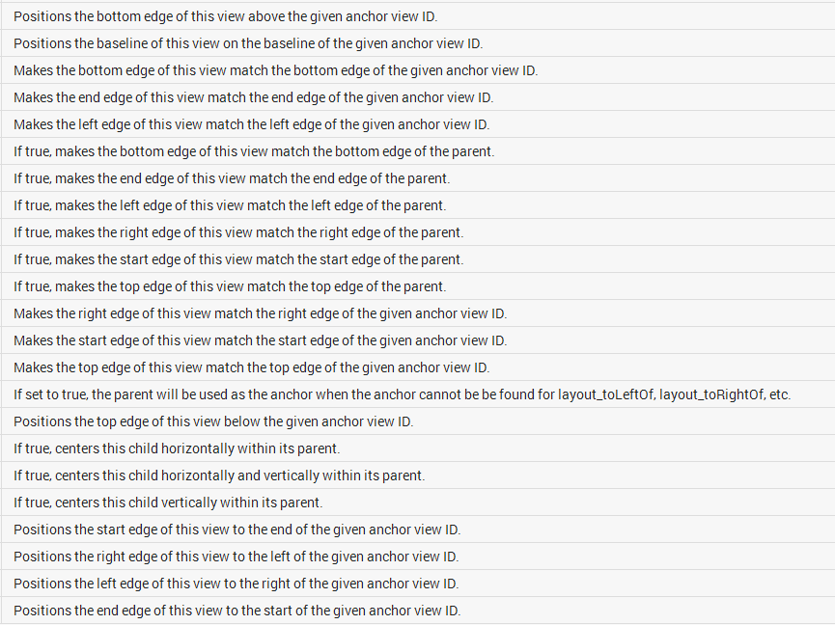
RelativeLayout Layout Parameters
www.hndit.com

Slide 35
About RelativeLayout
www.hndit.com
Unless you specify a vertical position/alignment, a child view will match the top of its parent.
Unless you specify a horizontal position/alignment, a child view will match the left of its parent.

Slide 36
Can we simplify the layout params used?
www.hndit.com
layout_alignParentTop
layout_below
layout_alignParentLeft
layout_below
layout_alignParentRight

Slide 37
Can we simplify the layout params used?
www.hndit.com
layout_below
layout_below
layout_alignParentRight

Slide 38
How do we make the bottom views pushed down to the bottom of their parent?
www.hndit.com
layout_below
layout_below
layout_alignParentRight

Slide 39
How do we make the bottom views pushed down to the bottom of their parent?
www.hndit.com
layout_alignParentBottom
layout_alignParentBottom
layout_alignParentRight

Slide 40
Using RelativeLayoutParams
www.hndit.com
Some layout parameters take true or false as values and others take View ids.

Slide 41
RelativeLayout Layout Params
www.hndit.com
Layout params that use true or false
  All layout parameters that have the word parent
  layout_centerHorizontal
  layout_centerVertical

Slide 42
RelativeLayout Layout Params
www.hndit.com
Layout params that use View ids
  Need to reference an existing id or create one for a view that will be defined later in the layout.
  Even if you aren’t planning on using an ID in code for finding a View. You still need it for RelativeLayout to layout views correctly.

Slide 43
Using existing ids
www.hndit.com
<?xml version="1.0" encoding="utf-8"?>
<RelativeLayout xmlns:android="http://schemas.android.com/apk/res/android"
android:layout_width="match_parent"
android:layout_height="match_parent"
android:layout_margin="10dp" >
<View
android:id="@+id/top"
android:layout_width="match_parent"
android:layout_height="200dp"
android:background="#F00"
android:layout_marginBottom="5dp" />
<View
android:id="@+id/left"
android:layout_width="150dp"
android:layout_height="75dp"
android:background="#000"
android:layout_below="@id/top" />
<View
android:id="@+id/right"
android:layout_width="100dp"
android:layout_height="75dp"
android:background="#000"
android:layout_below="@id/top"
android:layout_alignParentRight="true" />
</RelativeLayout>

Slide 44
Creating an id for layout params
www.hndit.com
<?xml version="1.0" encoding="utf-8"?>
<RelativeLayout xmlns:android="http://schemas.android.com/apk/res/android"
android:layout_width="match_parent"
android:layout_height="match_parent"
android:layout_margin="10dp" >
<View
android:id="@+id/top"
android:layout_width="match_parent"
android:layout_height="200dp"
android:background="#F00"
android:layout_marginBottom="5dp" />
<View
android:id="@+id/left"
android:layout_width="150dp"
android:layout_height="75dp"
android:background="#000"
android:layout_below="@id/top"
android:layout_toLeftOf="@+id/right"
android:layout_alignParentLeft="true"
android:layout_marginRight="5dp" />
<View
android:id="@id/right"
android:layout_width="100dp"
android:layout_height="75dp"
android:background="#000"
android:layout_below="@id/top"
android:layout_alignParentRight="true" />
</RelativeLayout>

Slide 45
Controlling Dimension of View with RelativeLayout params
www.hndit.com
With the available options, you can not only position views in relationship to other views, but you can also size views.

Slide 46

Controlling Size with Relative Layout
www.hndit.com
<?xml version="1.0" encoding="utf-8"?>
<RelativeLayout xmlns:android="http://schemas.android.com/apk/res/android"
android:layout_width="match_parent"
android:layout_height="match_parent"
android:layout_margin="10dp" >
<View
android:id="@+id/top"
android:layout_width="match_parent"
android:layout_height="200dp"
android:background="#F00"
android:layout_marginBottom="5dp" />
<View
android:id="@+id/left"
android:layout_width="75dp"
android:layout_height="75dp"
android:background="#000"
android:layout_below="@id/top"
android:layout_alignParentLeft="true"
android:layout_marginRight="5dp" />
<View
android:id="@+id/right"
android:layout_width="100dp"
android:layout_height="75dp"
android:background="#000"
android:layout_below="@id/top"
android:layout_alignParentRight="true" />
</RelativeLayout>
How to make the View @id/left’s right edge extend to View @id/right?

Slide 47
RelativeLayout Layout Parameters
www.hndit.com

Slide 48

Controlling Size with RelativeLayout
www.hndit.com
<?xml version="1.0" encoding="utf-8"?>
<RelativeLayout xmlns:android="http://schemas.android.com/apk/res/android"
android:layout_width="match_parent"
android:layout_height="match_parent"
android:layout_margin="10dp" >
<View
android:id="@+id/top"
android:layout_width="match_parent"
android:layout_height="200dp"
android:background="#F00"
android:layout_marginBottom="5dp" />
<View
android:id="@+id/left"
android:layout_width="75dp"
android:layout_height="75dp"
android:background="#000"
android:layout_below="@id/top"
android:layout_alignParentLeft="true"
android:layout_toLeftOf="@+id/right"
android:layout_marginRight="5dp" />
<View
android:id="@id/right"
android:layout_width="100dp"
android:layout_height="75dp"
android:background="#000"
android:layout_below="@id/top"
android:layout_alignParentRight="true" />
</RelativeLayout>

Slide 49
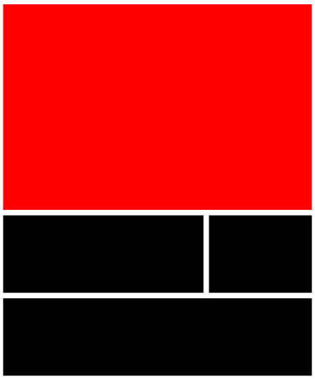
How to make a new View’s left edge match @id/left and right’s edge match @id/right?
www.hndit.com
<?xml version="1.0" encoding="utf-8"?>
<RelativeLayout xmlns:android="http://schemas.android.com/apk/res/android"
android:layout_width="match_parent"
android:layout_height="match_parent"
android:layout_margin="10dp" >
<View
android:id="@+id/top"
android:layout_width="match_parent"
android:layout_height="200dp"
android:background="#F00"
android:layout_marginBottom="5dp" />
<View
android:id="@+id/left"
android:layout_width="75dp"
android:layout_height="75dp"
android:background="#000"
android:layout_below="@id/top"
android:layout_alignParentLeft="true"
android:layout_toLeftOf="@+id/right"
android:layout_marginRight="5dp" />
<View
android:id="@id/right"
android:layout_width="100dp"
android:layout_height="75dp"
android:background="#000"
android:layout_below="@id/top"
android:layout_alignParentRight="true" />
</RelativeLayout>

Slide 50
How to make a new View’s left edge match @id/left and right’s edge match @id/right?
www.hndit.com
<?xml version="1.0" encoding="utf-8"?>
<RelativeLayout xmlns:android="http://schemas.android.com/apk/res/android"
android:layout_width="match_parent"
android:layout_height="match_parent"
android:layout_margin="10dp" >
<View
android:id="@+id/top"
android:layout_width="match_parent"
android:layout_height="200dp"
android:background="#F00"
android:layout_marginBottom="5dp" />
<View
android:id="@+id/left"
android:layout_width="75dp"
android:layout_height="75dp"
android:background="#000"
android:layout_below="@id/top"
android:layout_alignParentLeft="true"
android:layout_toLeftOf="@+id/right"
android:layout_marginRight="5dp" />
<View
android:id="@id/right"
android:layout_width="100dp"
android:layout_height="75dp"
android:background="#000"
android:layout_below="@id/top"
android:layout_alignParentRight="true" />
<View
android:layout_width="0dp"
android:layout_height="75dp"
android:layout_marginTop="5dp"
android:background="#000"
android:layout_below="@id/left"
android:layout_alignLeft="@id/left"
android:layout_alignRight="@id/right" />
</RelativeLayout>

Slide 51

The Power of RelativeLayouts
www.hndit.com
With all the different layout parameters, one can see why RelativeLayout is super powerful.

Slide 52
The Power of RelativeLayouts
www.hndit.com
Many novice Android Devs will over use LinearLayouts by having several nested inside each other to accomplish a task that is done much easier with RelativeLayout.
Good Android Devs will use the minimum numbers of Views required to accomplish a layout.

